Slide 1


SDN302
FINAL PROJECT PRESENTATION
SAN SIEU TOC - Sport Fields Management System

Slide 2

I. Project Overview
II. System Actors - Manager
III. System Actors - Customer
IV. System Actors - Guest
V. Screen Flow - Guest Flow
VI. Screen Flow - Customer Flow
VII. Screen Flow - Manager Flow
VIII. Technology Stack & Core Contributions
TABLE OF CONTENT

Slide 3
Project Overview
  San Sieu Toc (Field Booking System) was developed to solve the inefficiencies of manual sports field management, such as schedule conflicts, lack of transparency, and time-consuming phone bookings.
  Our platform empowers users to instantly discover, book, and manage sports fields with ease. Simultaneously, it provides field owners with a centralized digital dashboard to optimize daily schedules, track revenue, and prevent booking overlaps accurately.

Slide 4
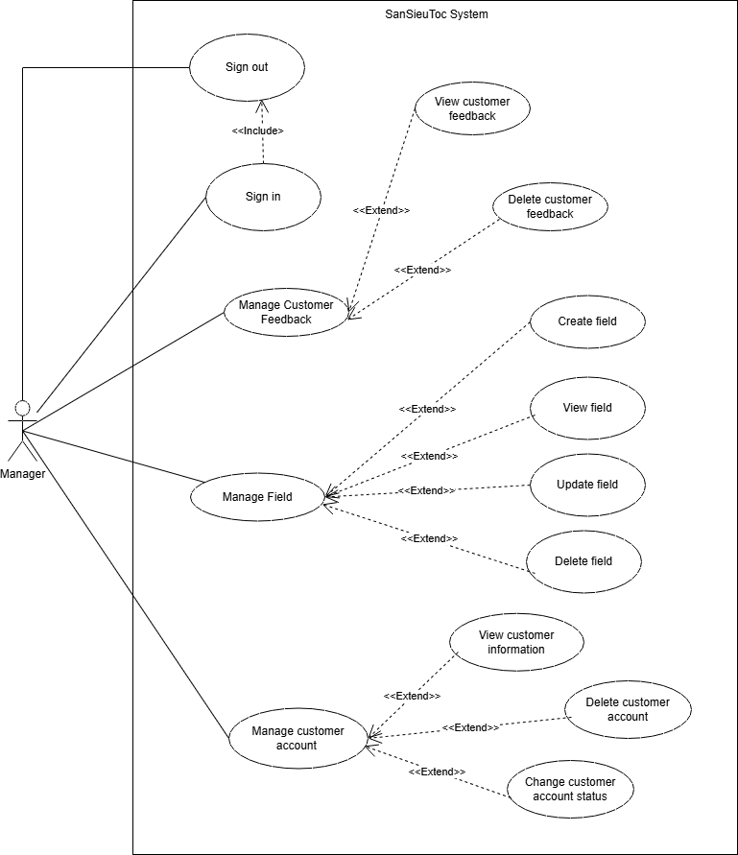
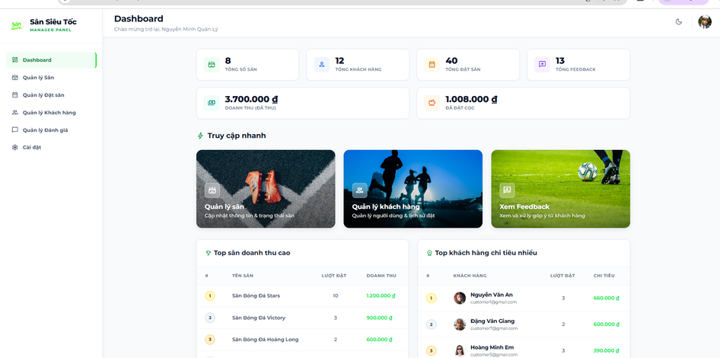
System Actors
Manager:
  Fields management
  Booking approval
  Customer management
  View revenue statistics
  Fields Feedback
  Manage the closing time for each court and the duration for the system to create slots.

Slide 5
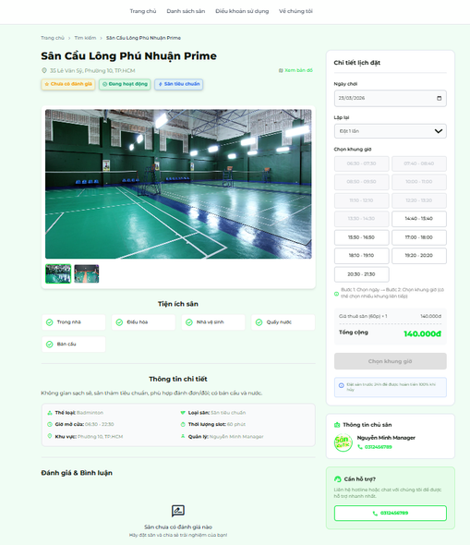
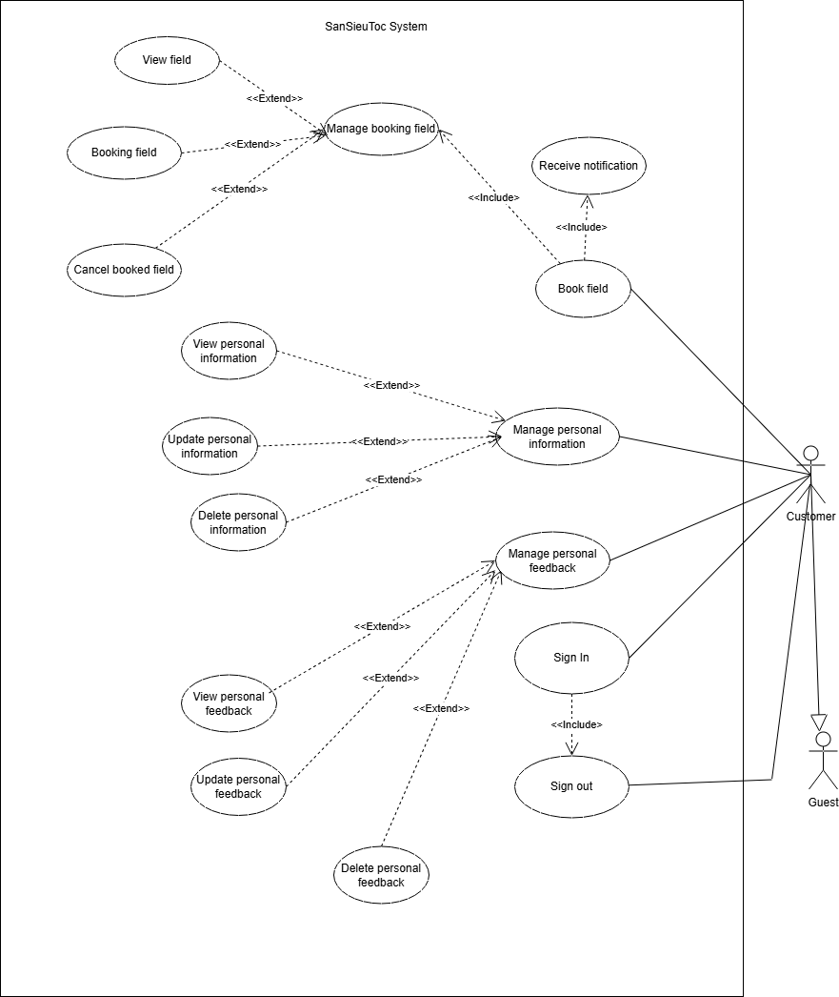
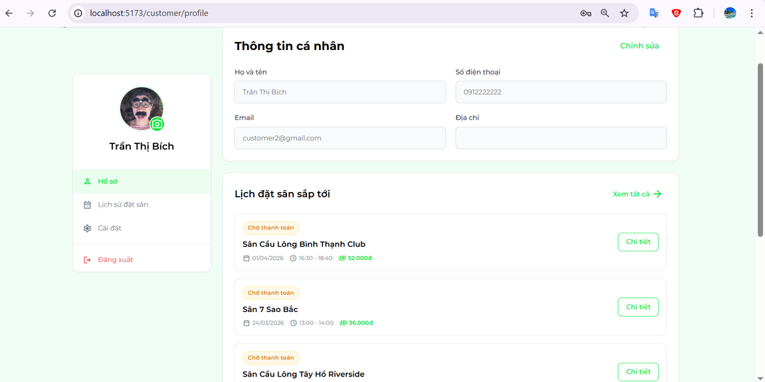
System Actors
Customer:
  Search for Fields
  Book individual slots
  Pay deposits
  Manage bookings history
  Leave reviews (Feedback).

Slide 6
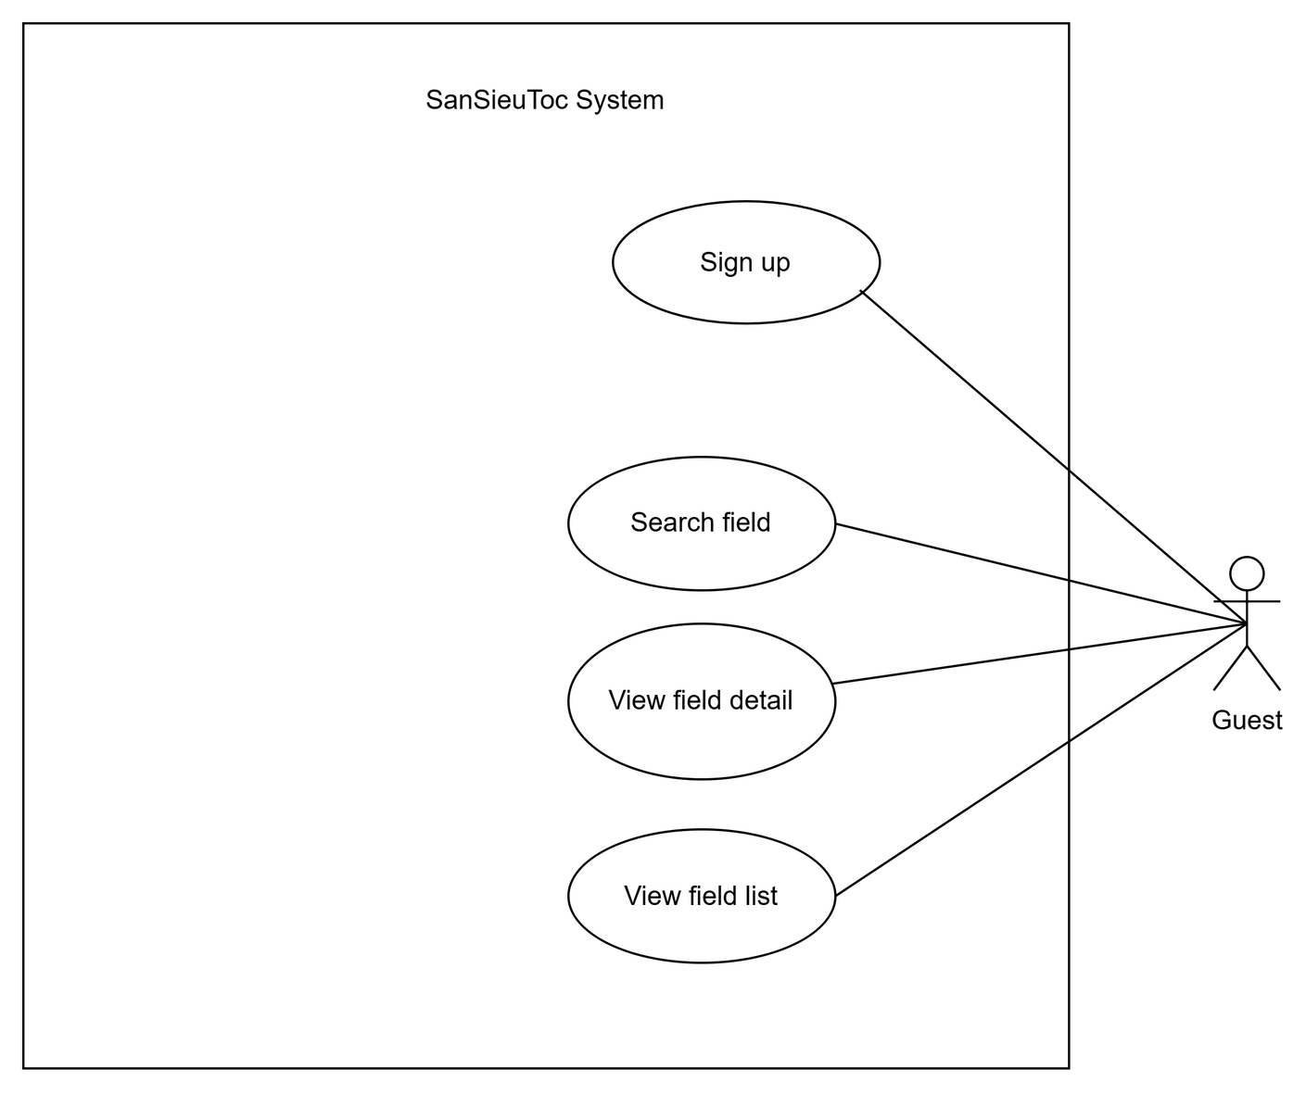
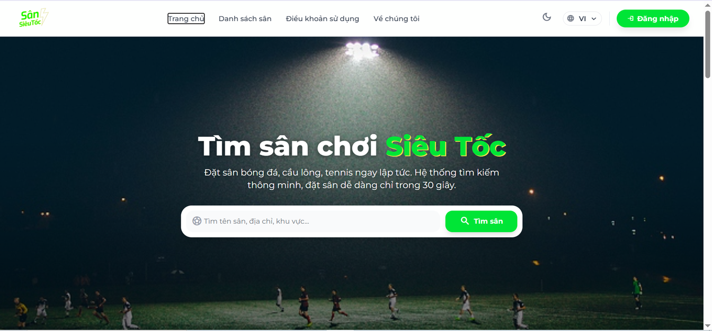
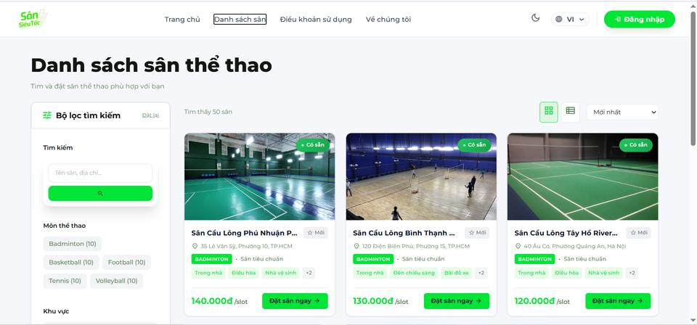
System Actors
Guest:
  Search for Fields
  View details Field

Slide 7
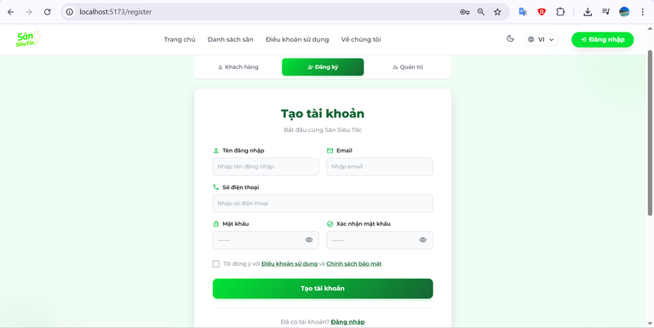
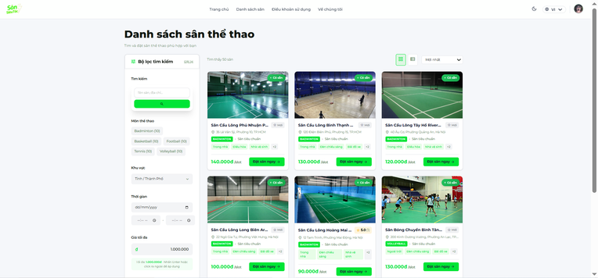
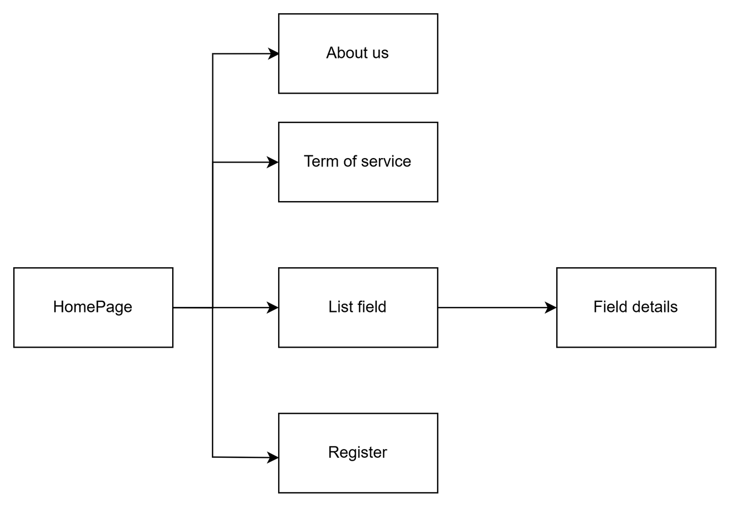
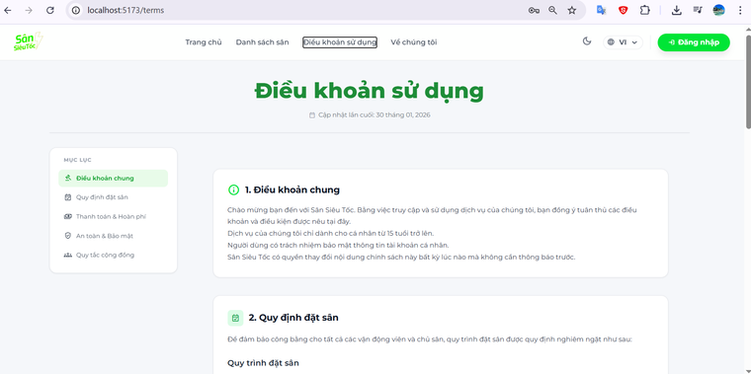
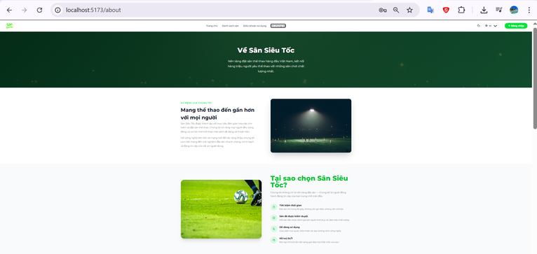
SCREENS FLOW - GUEST FLOW

Slide 8
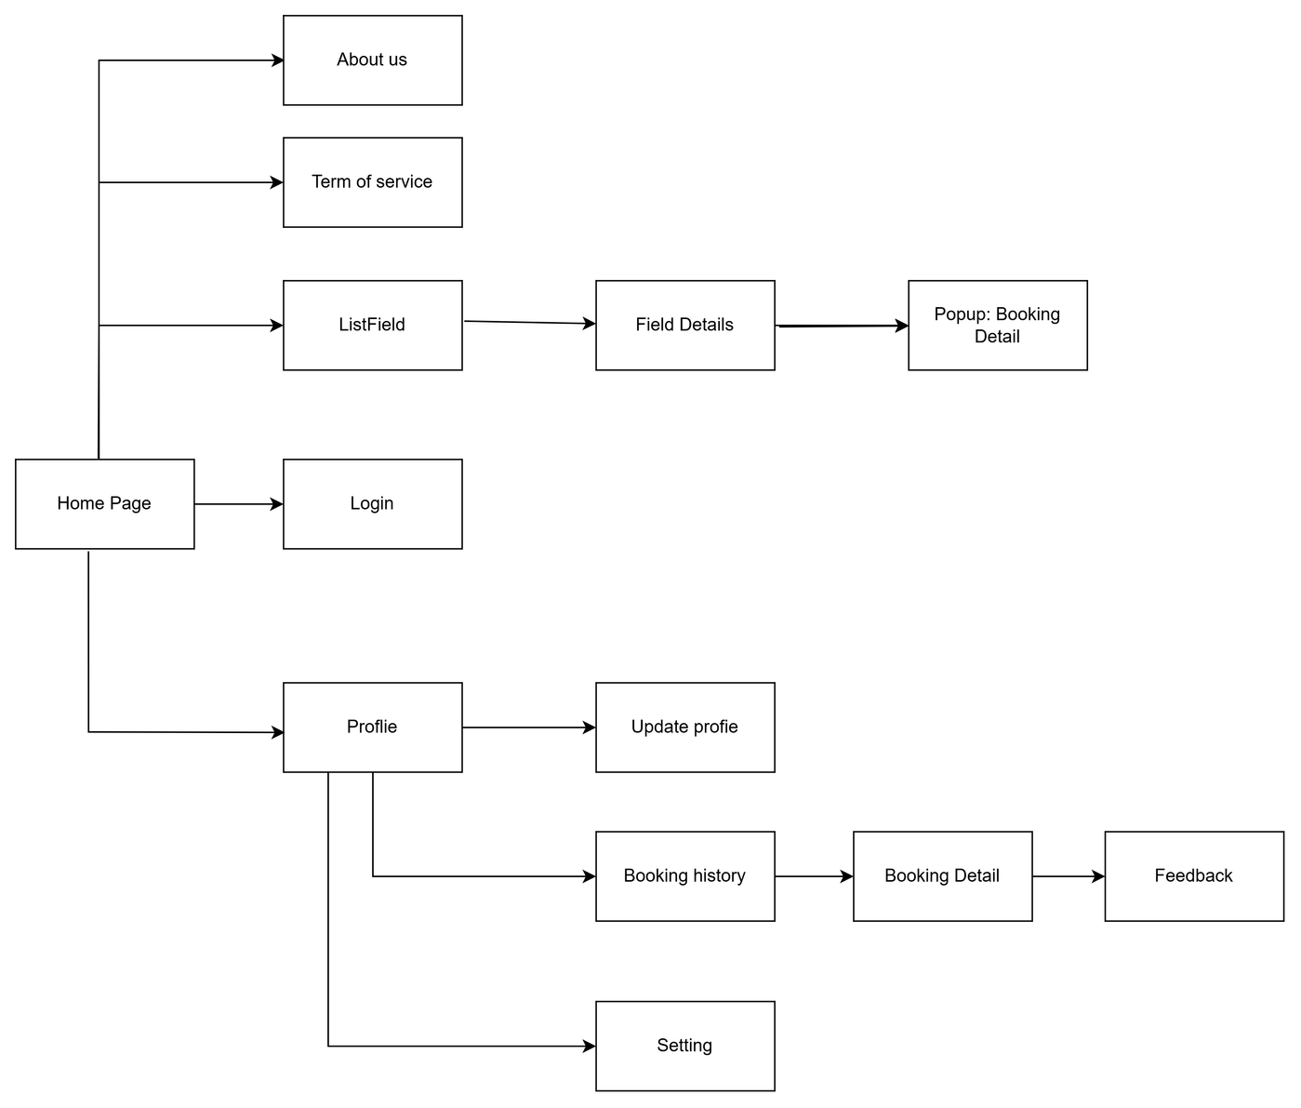
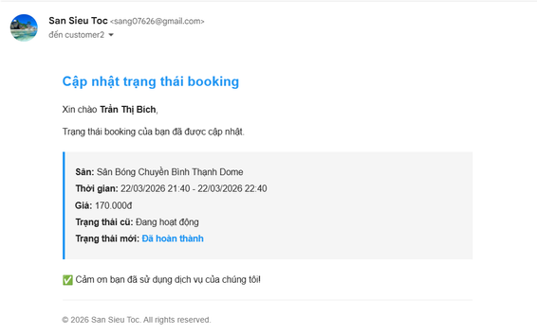
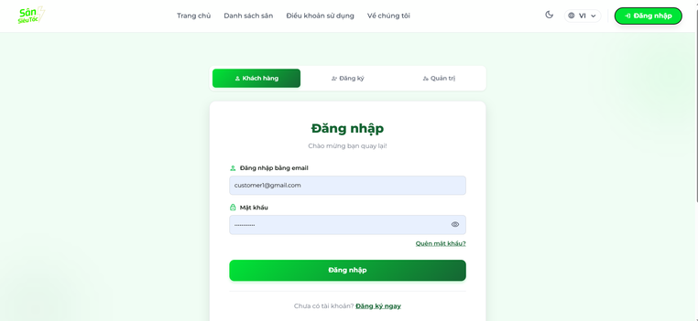
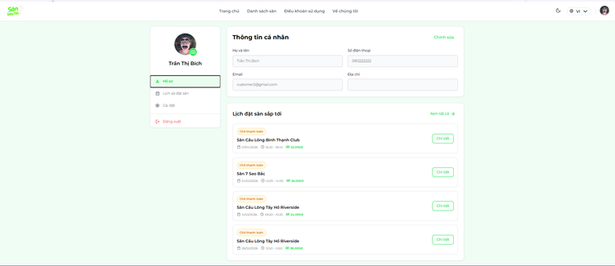
SCREENS FLOW - CUSTOMER FLOW

Slide 9
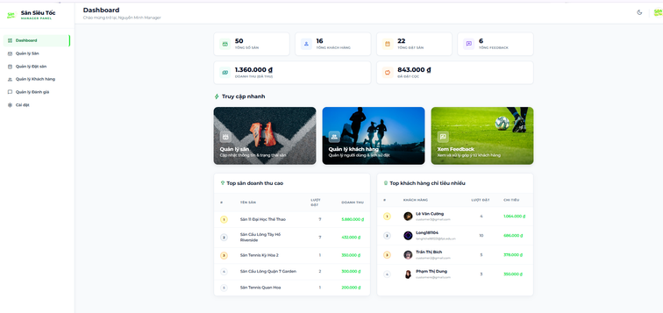
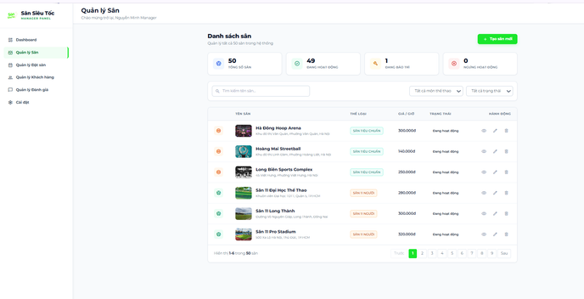
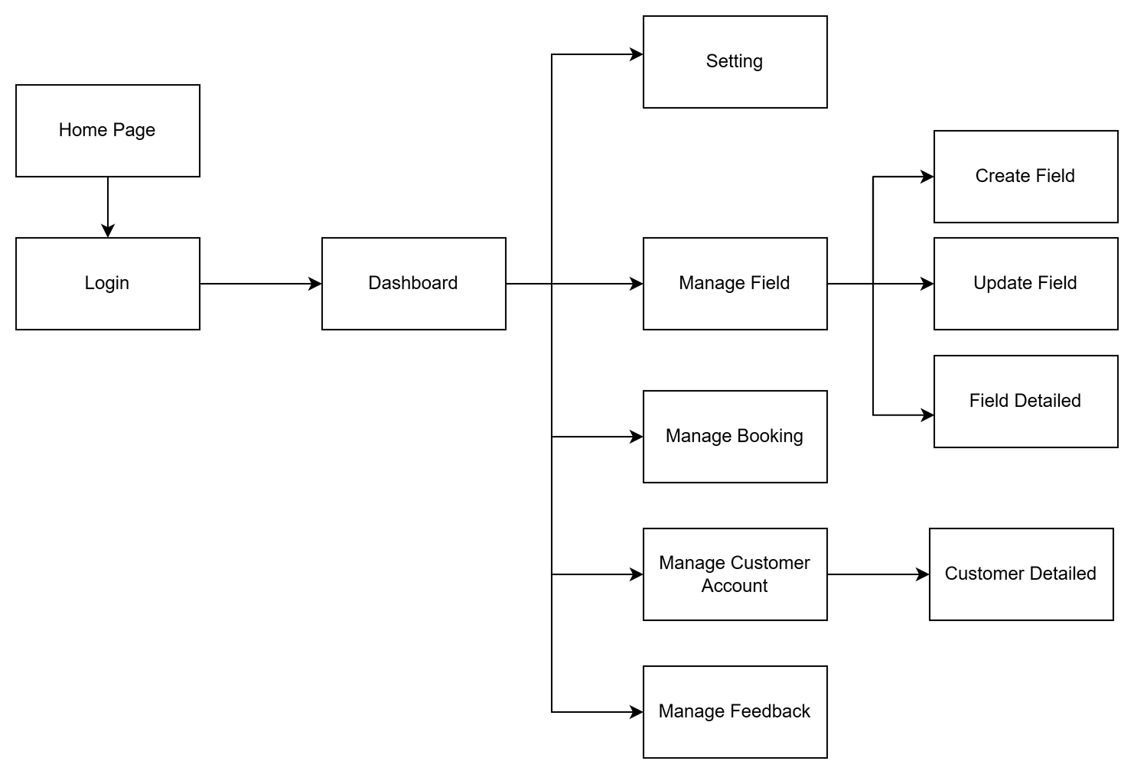
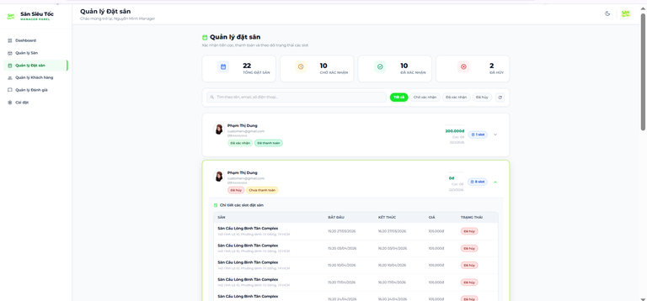
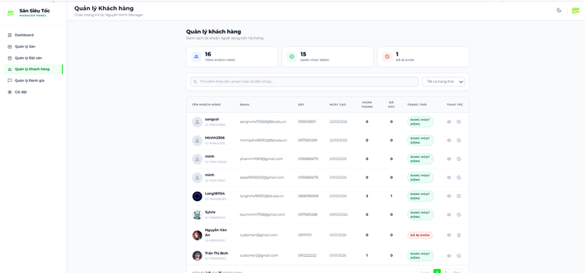
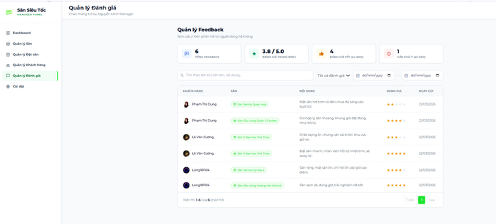
SCREENS FLOW - MANAGER FLOW

Slide 10














Technology Stack & Core Contributions
1. Frontend (Client-side)
  React + Vite + Tailwind CSS
2. Backend (Server-side)
  Node.js + Express.js
  Nodemailer
3. Database
  MongoDB
4. Utilities & Integrations
  Cloudinary
5. Development & Collaboration Tools
  Visual Studio Code (VS Code)
  GitHub
  Word
  Draw.io
6. Security
  JWT (JSON Web Token) & Bcrypt

Slide 11
THANK YOU

